Slide 1
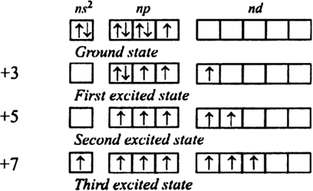
OXIDATION STATES OF d-BLOCK ELEMENTS

Slide 2
VARIABLE OXIDATION STATE
The variable oxidation states shown by the transition elements are due to the participation of outer ns and inner (n–1)d-electrons in bonding.
Except scandium, the most common oxidation state shown by the elements of first transition series is +2.
This oxidation state arises from the loss of two 4s electrons.

Slide 3
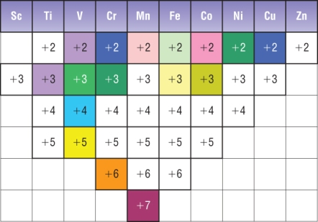
3d SERIES OXIDATION STATES

Slide 4
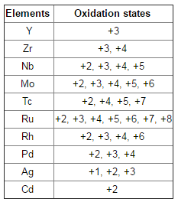
4d SERIES OXIDATION SERIES

Slide 5
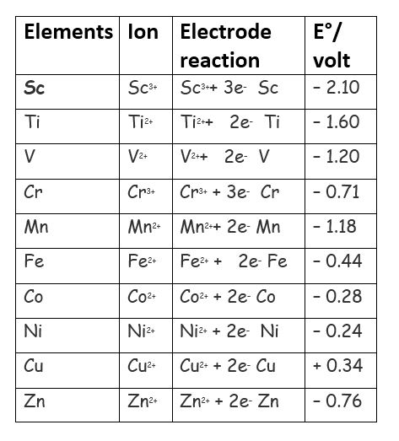
STANDARD ELECTRODE POTENTIAL

